Slide 1
Predicting Data Exfiltration via DNS
Zep analytics Internship task

Slide 2
Use Case:
Create a static machine learning model based on batch data. The dataset that is used is from top secret files obtained from our allies Ring Canada (RC) and the Cyber Threat Intelligence (CTI). The dataset provided to you has DNS traffic generated by exfiltrating various filetypes ranging from small to large sizes.
The aim of the task is to implement a binary classifier aiming at predicting data exfiltration via DNS.

Slide 3
Work Agenda
Exploratory Data Analysis (EDA)
Data cleaning
Feature engineering
Model Training and Model evaluation

Slide 4
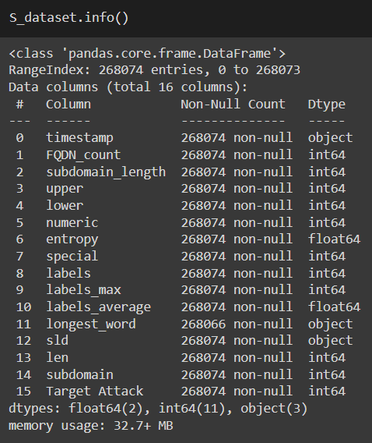
Exploratory Data Analysis (EDA)
Using the file called “static_dataset.csv”
checked using plots and statistical tools the distribution of each feature and the target variable
checked any type of data skewed pattern.
Validated if your dataset is imbalanced
Data Information:
The dataset is of shape (268074, 16) consists of 16 features 2 float numbers and 3 of object type and the remaining features are integer type.

Slide 5
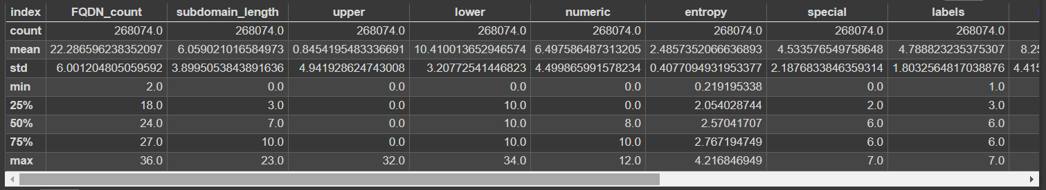
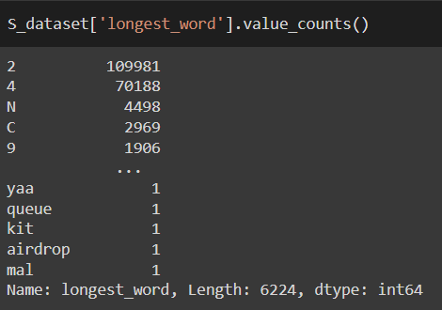
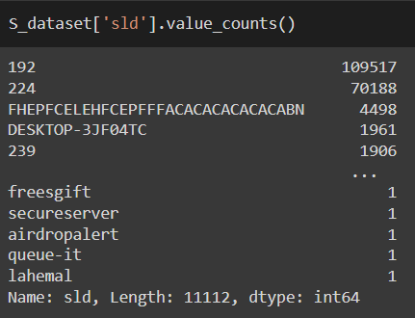
Exploratory Data Analysis (EDA)
Data Description
String Columns

Slide 6
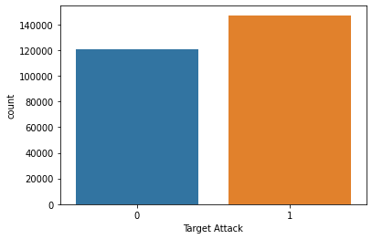
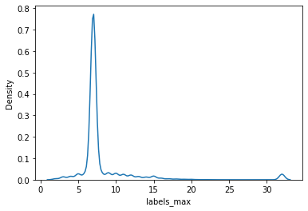
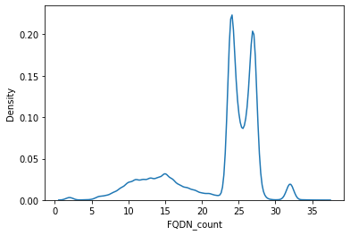
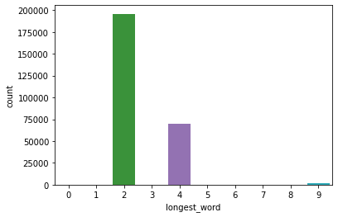
Exploratory Data Analysis (EDA)
Count the Target Attacks
Skewness of labels max
Skewness of FQDN
Count of longest word

Slide 7
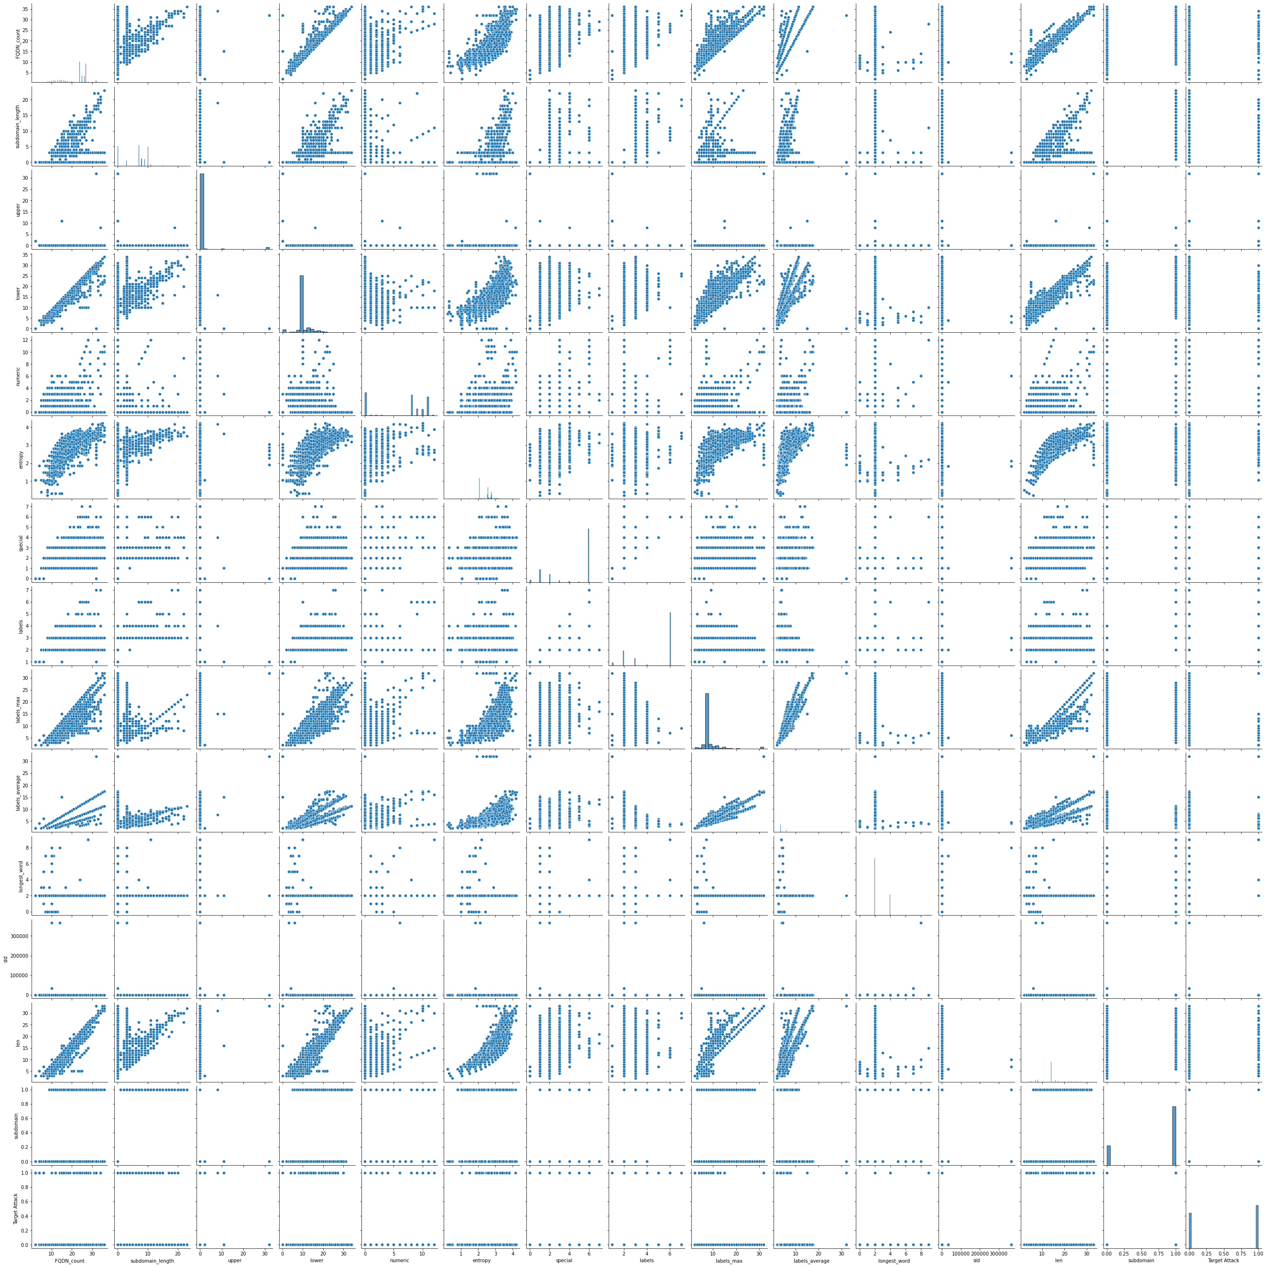
Feature Correlation

Slide 8
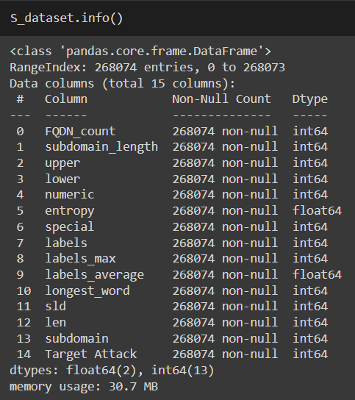
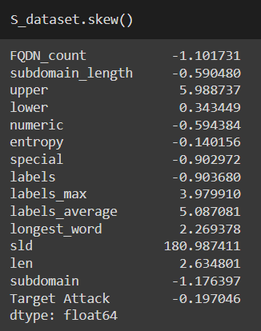
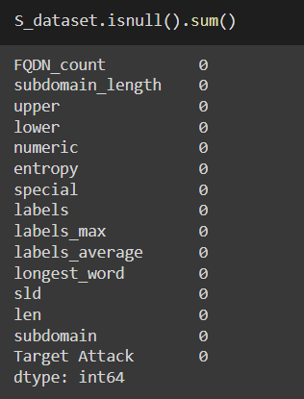
Data cleaning
String columns is converted to integers
Check Skewness of the features
Check there is no null values

Slide 9
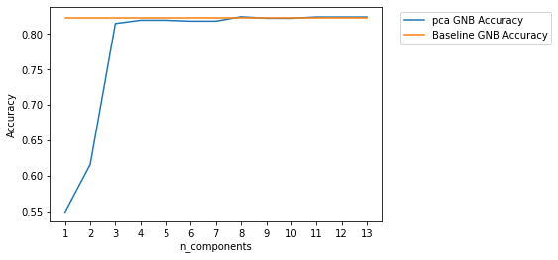
Feature engineering
Applied PCA dimensionality reduction on the dataset and found that best component is 13

Slide 10
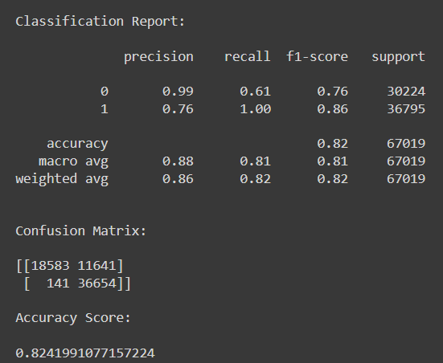
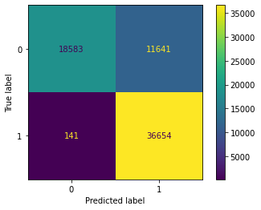
Model Training and Evaluation
Logistic Regression Model is used for binary classification problem

